Slide 1
ESSENTIAL ELEMENTS OF COMPREHENSIVE NURSING CARE
July 2023

Slide 2
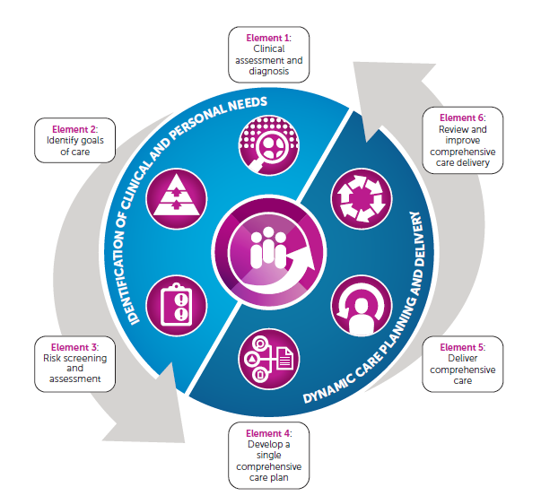
Essential Elements of Comprehensive Care
Notes:
The intent of the comprehensive care standard is to provide patient centred care and ensure risks of harm are prevented and managed whilst in hospital

Slide 3
Clinical Assessment
Key actions
■ Use person-centred approaches to discuss current status and conditions
■ Consider the patient’s health literacy, and tailor your communication style
■ Apply clinical reasoning to reach conclusions about nursing care
■ Use the provisional diagnoses and assessment to inform care
■ Include the results of the clinical assessment and interventions in the comprehensive care plan.
Notes:
The Nursing Assessment is where you gather the subjective and objective data related to your patient.
Talking with patients about their needs and preferences helps clarify what is important to them as an individual

Slide 4
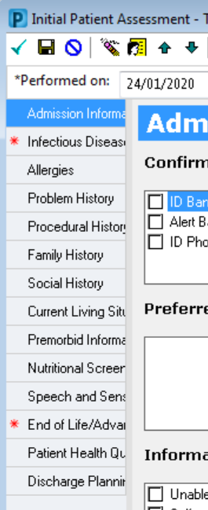
Document the Patient Assessment
Assessment
Gather subjective & objective patient baseline data
Complete in EMR:
Basic Admission Assessment
Adult Initial Patient Assessment
Notes:
All patients require documentation completed on admission to identify the patient’s baseline condition.
Admission documentation in the EMR includes:
The Basic Admission Assessment Adult (Vital Signs and Weights)
The Initial Patient Assessment – the questions in the Risk Assessments contribute to the comprehensive care risk assessment and dashboard

Slide 5
Goal Planning
Key actions
■ Use person-centred approaches to discuss patient goals of care
■ Consider the patient’s health literacy, and tailor your communication style
■ Use the about me form to understand key items of importance for our patients/consumers
■ Identify who the patient/consumer wants involved in discussions, interventions and goal planning
■ Use the patient goals to inform the comprehensive care plan (IPOC)
■ Document and communicate the patient goals discussion.
Notes:
Talking with patients about their needs and preferences helps clarify what is important to them as an individual
Complete the “About Me” form to provide the team with information that is important to your patient

Slide 6
Risk Assessment & Diagnosis
Key actions
■ Discuss personal factors with patients that might contribute to risk of harm
■ Use risk assessment approaches to mitigate risks and improve patient care
■ Use clinical judgement to inform decisions about potential risks of harm, and actions to mitigate risk
■ Document and communicate the risk assessment processes and actions in the comprehensive care plan.
Conduct a comprehensive risk assessment
Delirium / confusion - Pressure Injury - Nutrition - Continence - Falls - OVA - Self-harm and suicide
Identify additional risk factors such as: - Agitation or impaired judgement - Communication issues - Requiring End of Life Care - Frequency or need for assisted toileting - Previous falls - Prescription drugs - Older age/ frailty / reduced mobility - Underlying chronic disease
Notes:
Risk screening and assessment are a core part of comprehensive care. As well as identifying clinical issues, they also support decision making about treatment and risk mitigation.

Slide 7
Document Risk Assessment & Nursing Diagnosis
Identify Risk & Nursing Diagnosis
Risk assessment & diagnosis
Actual diagnosis
Complete in EMR:
Adult Risk Assessment
Nursing Admission Note
2
1
Notes:
The remainder of the comprehensive care risk assessment can be found in the Adult Risk Assessment which is located via the Interactive View and Fluid Balance tab. (Iview)
The nursing admission note is found via the nurse view MPage

Slide 8
Develop a Comprehensive
Care Plan (IPOC)
Key actions
■ Use interventions and risk mitigation strategies to improve patient outcomes
■ Engage with the multidisciplinary team and communicate effectively to plan the patient’s care
■ Include patients, family, carers and support people in comprehensive care planning and alignment with patient goals of care
■ Ensure information in the comprehensive care plan is current, accurate, relevant and succinct.
Develop an Individualised, comprehensive plan
Goals of treatment consistent with patient’s values
Specific nursing interventions
Allied health interventions as required
Clinical Observations and frequency of monitoring
Specialist assistance as required
Minimum Strategies
Safety Check every shift
Head to Toe skin assessment every shift
Falls assessment every day
Monitor for changes in behaviour /Cognition every shift
Encourage mobility as appropriate e.g. sit out of bed,
change into day clothes
- Regular repositioning if reduced mobility
Notes:
The Comprehensive Care IPOC details preventative actions for all risks associated with the comprehensive care standard and should be completed with every patient and include patient specific goals.

Slide 9
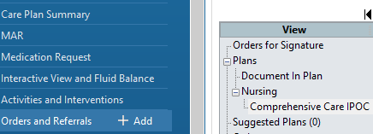
Document the Comprehensive Care Plan (IPOC)
Care Planning
Establish goals of care with the patient
Select interventions to achieve the goals
Add how often the intervention is planned
Complete in EMR:
Orders, Suggested Plans,
Comprehensive Care IPOC
2
1
Notes:
Navigate to the Orders Tab in the Table of Contents. Every patient will have a Comprehensive Care IPOC in Suggested Plans.
The individual IPOCs for components such as falls, pressure injuries, delirium, OVA) only need to be initiated if that problem has already occurred.
For example: the falls risk IPOC only needs to be completed if the patient has had a fall.
Despite the EMR suggesting these IPOCs, there is no need to initiate extra IPOCs unless the problem has actually occurred.

Slide 10
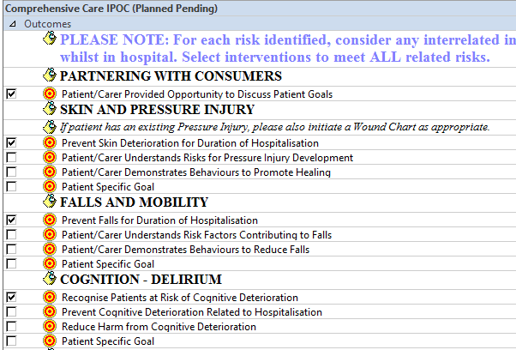
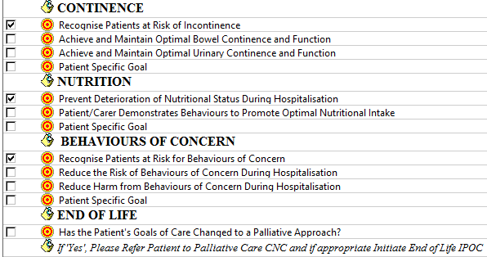
Document Patient Goals and intended outcomes in the (IPOC)
Notes:
Identifying and setting goals of care in collaboration with the patient, ensures care is individualised.
Having a clear, shared understanding of goals of care is increasingly important when a patient has complex healthcare issues, such as multiple comorbidities or a life-limiting illness.

Slide 11
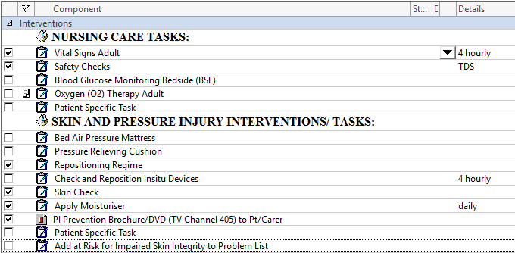
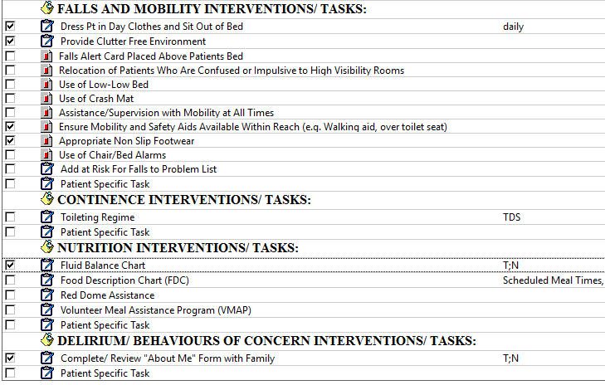
Document Planned Interventions in the (IPOC)
Notes:
The interventions should be documented within the IPOC to achieve the desired outcomes e.g. falls prevention strategies.
You can add the timing of specific interventions that will be visible as a task on care compass for other members of the nursing team caring for the patient as well as referrals to allied health

Slide 12
Deliver Comprehensive Care
Key actions
■ Deliver person-centred care that is appropriate for the patient
■ Work collaboratively in a multidisciplinary team to achieve the patient’s goals ■ Care for the patient in a dynamic and individualised way,
■ Involve family, carers and support people in in alignment with patient wishes
Assess cognition and screen for delirium every shift - Manage continence, such as toilet frequently - Implement fall injury prevention strategies where indicated. - Ensure consistent communication between care providers. - Provide a call bell to patients to contact nurses for assistance. - Protocol in place to address extra precautions needed for patients with cognitive impairment. - Implement skin protection strategies
Head to Toe skin assessment every shift
- Patient and family input where feasible
Identify and treat reversible causes of incontinence - Assistance for patients who wear hearing and visual aids - Correct dehydration, malnutrition and constipation - Regular pain assessment and management -Regular reorientation and reassurance -Help with feeding, oral supplements and/or nutrition support - Regular repositioning
Notes:
Delivering comprehensive care should include relevant clinical disciplines working together in a multidisciplinary team to achieve the goals of care.
Patients, families, carers and other support people are also essential for the delivery of comprehensive care.

Slide 13
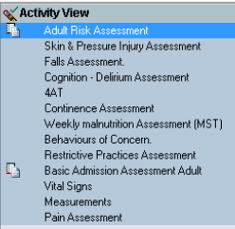
Document Nursing Interventions
Nursing Care Delivery
Direct Care
Complete in EMR
Care Compass, iView
Activities & Interventions
Nursing Shift Progress Note
3
1
2
Notes:
The majority of day to day nursing & midwifery interventions are documented via Care Compass, iView and Activities & Interventions.
This includes activities such as vital signs, fluid balance, management of lines and devices etc
Document any variations and discussions with family / carers in the nursing shift progress note

Slide 14
Review Comprehensive Care
Key actions
■ Review comprehensive care delivery with the patient
■ Be responsive and alert to changes in the patient’s circumstances
■ Work collaboratively with the multidisciplinary team to review and communicate changes in the patient’s circumstances
■ Involve family, carers and support people in alignment with patient’s wishes.
Monitor the effectiveness of fall prevention strategies, and
reassess if fall occurs
Monitor the effectiveness of delirium prevention strategies, and reassess if delirium occurs
Monitor the effectiveness of malnutrition prevention strategies and reassess if malnutrition occurs
Monitor the effectiveness of incontinence prevention strategies and reassess if persistent incontinence occurs
Put referrals in place to address deconditioning
Review regarding resolution of delirium or the
emergency of ongoing cognitive impairment
Shift by shift pressure injury risk assessment, at least weekly pressure injury healing assessment
Provide information for patient and GP upon
discharge
Notes:
Review of comprehensive care delivery involves revisiting diagnoses, clinical and personal goals of care to ensure the plan remains appropriate and effective
The care plan should be reviewed to identify changes in the patient’s condition, expectations, needs, diagnoses or prognosis

Slide 15
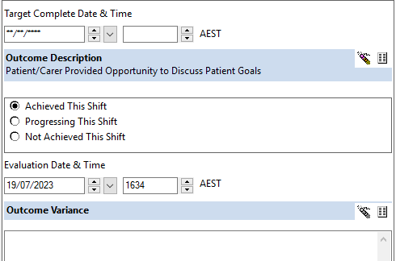
Review the care plan (IPOC)
Evaluation
If the problem is resolving as planned
Complete in EMR:
Document in Plan - Review and tick if todays goals were achieved, in progress or not achieved
1
3
2
4
Notes:
Remember, after an IPOC has been initiated it should be reviewed each shift to ensure it is still relevant to the patient.
This is done via the Document in Plan tab in the comprehensive care IPOC in the orders section of the EMR .
To track progress against existing goals, Add the target date to reach the goal. Tick if the goal has been achieved, not achieved or progressing.
The nursing shift note should also be used to document any variations in care or outcomes

Slide 16
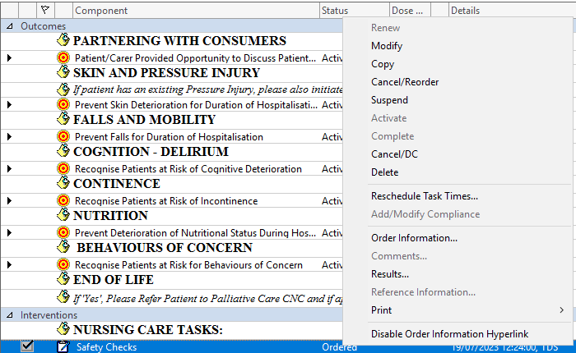
Review the care plan (IPOC)
Evaluation
If the problem is not resolved - reassess the cause and modify the interventions
Complete in EMR:
Go to Orders & referrals
“Right click” the goal / intervention and select ‘modify’ to update frequency/ timing.
Add a Nursing Shift Progress Note
1
2
3
4
Notes:
If the goal is progressing but requires additional interventions.
You can modify existing goals or interventions , select the goal or Intervention, Right click and select modify
The nursing shift note should also be used to document any variations in care or outcomes

Slide 17
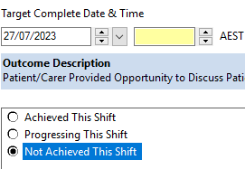
Review the care plan (IPOC)
Evaluation
If the problem is not resolved –and you need to add Goals / interventions
Complete in EMR:
Document in Plan to Review
“Add to phase” to add additional goals/ interventions
Add a Nursing Shift Progress Note
1
3
2
Notes:
To add additional goals or interventions , select “Add to Phase” then “Add outcome/Intervention”
The nursing shift note should also be used to document any variations in care or outcomes

Slide 18
Clinical Assessment
Gathering subjective & objective patient baseline data
Complete in EMR:
Basic Admission Assessment
Adult Initial Patient Assessment
Identify Patient Goals
With the Patient
Complete in EMR:
IPOC – Intended outcomes
Risk Assessment Diagnosis
Risk Assessment
Actual Diagnosis
Complete in EMR:
Adult Risk Assessment
Care Planning
Select Interventions to achieve the goals
Complete in EMR:
Orders, Suggested Plans
Comprehensive Care IPOC
Care Delivery
Direct Care
Complete in EMR:
Care Compass, iView
Activities & Interventions
Evaluation
Confirm the problem is resolved
If the problem is not resolved – reassess the cause of the problem and change the interventions
Complete in EMR:
Document in IPOC
Nursing Progress Shift Note
Essential Elements of
Comprehensive Care

Slide 19
References
https://www.safetyandquality.gov.au/publications-and-resources/resource-library/implementing-comprehensive-care-standard-deliver-comprehensive-care
https://www.safetyandquality.gov.au/publications-and-resources/resource-library/comprehensive-care-element-1-clinical-assessment-and-diagnosis-key-actions-clinicians
https://www.safetyandquality.gov.au/publications-and-resources/resource-library/comprehensive-care-element-2-identifying-goals-care-tips-clinicians
https://www.safetyandquality.gov.au/publications-and-resources/resource-library/comprehensive-care-element-3-risk-screening-and-assessment-key-actions-clinicians
https://www.safetyandquality.gov.au/publications-and-resources/resource-library/comprehensive-care-element-4-develop-single-comprehensive-care-plan-key-actions-clinicians
https://www.safetyandquality.gov.au/publications-and-resources/resource-library/comprehensive-care-element-5-deliver-comprehensive-care-key-actions-clinicians
https://www.safetyandquality.gov.au/publications-and-resources/resource-library/comprehensive-care-element-6-review-and-improve-comprehensive-care-delivery-key-actions-clinicians
https://www.safetyandquality.gov.au/publications-and-resources/resource-library/components-comprehensive-care-plan-information-clinicians
https://www.safetyandquality.gov.au/publications-and-resources/resource-library/comprehensive-care-delivery-overview-clinicians

