Slide 1
Message Design Checklist
Notes:
Ver 2020-1119
Presenter's Name
Presenter's Name

Slide 2
Directions for Use
Before delivering your next memo or presentation, check your communications against the following design checklist:
Checklist items for all messages types can be found on slides 3-4.
Checklist items specific to presentations can be found on slides 5-6.
Checklist items specific to memos or emails can be found on slides 7-8.

Slide 3
Check 1 (All Messages): Less Is More
What is the minimum amount of information needed to get the point of the message? Simple messages focus on essential language and graphics needed to make a point. The concepts you are communicating may be complex, but simplifying your messages makes them easier to understand.
Presentations
Memos
Meet the Team!
Word Count: 151 words
Dear Colleagues,
As a science-led company, we are committed to developing and delivering high-quality, targeted medical devices that make a difference in 15 countries around the…
Meet the Team!
Word Count: 37 words
Dear Colleagues,
Company A is committed to delivering medical devices that improve the lives of millions around the globe. Our prices must balance…

Slide 4
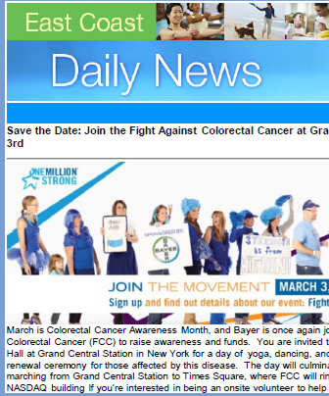
Check 2 (All Messages): Optimize for Mobile
Is critical information presented in a mobile-friendly way? Gartner research shows that 81% of users report reading email on mobile. Additionally, nearly all meeting and conference platforms are mobile compatible. Critical information should be placed at the top of the message and emphasized to reduce the need for scrolling by mobile users.
News of the Day
Company B Giving Back: 5k Run for Colorectal Cancer Awareness at Grand Central on March 3
Join your colleagues and
get outdoors for a 5k co-sponsored between Company B and Fight Colorectal Cancer (FCC) to raise funds and awareness.
Source: Gartner

Slide 5
Check 3 (Presentations): Create a Hierarchy
Will my audience notice the important information first? Visual hierarchy influences the order in which the eye sees and helps guide a reader to understand what is important. Direct your readers attention to what is important by applying contrast between elements, such as font size and weight, color variation or intensity, or the size of individual elements.
Source: Gartner

Slide 6
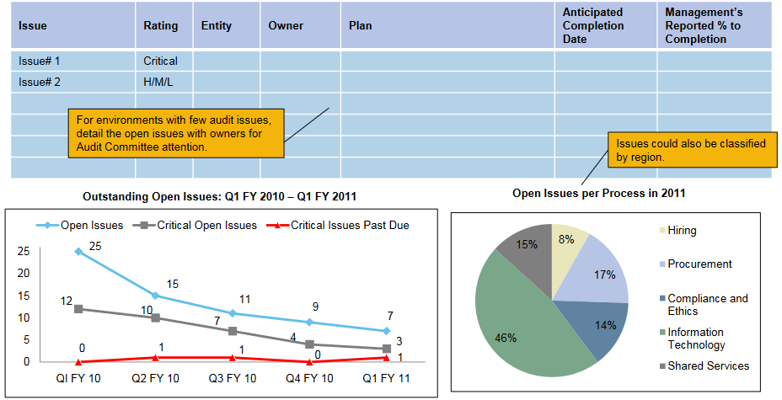
Check 4 (Presentations): Be Consistent
Are my visuals used consistently? Using graphic elements (e.g., font, call-outs and graphs) in a consistent way helps increase the speed and ease of message comprehension. By using visuals the same way on each page of your presentation, your audience can get adjusted to the page and follow along with your message more easily.
Q3 Audit Committee Report
Q3 Audit Committee Report
Executive Summary
Agenda for the Day
Agenda for the Day
Executive Summary
Remediation
Executive Summary
Top Line:
Top Line:
Remediation Plans
Remediation Plans
Top Line: As a whole, management has improved…
As a whole, management has improved…
Source: Gartner

Slide 7
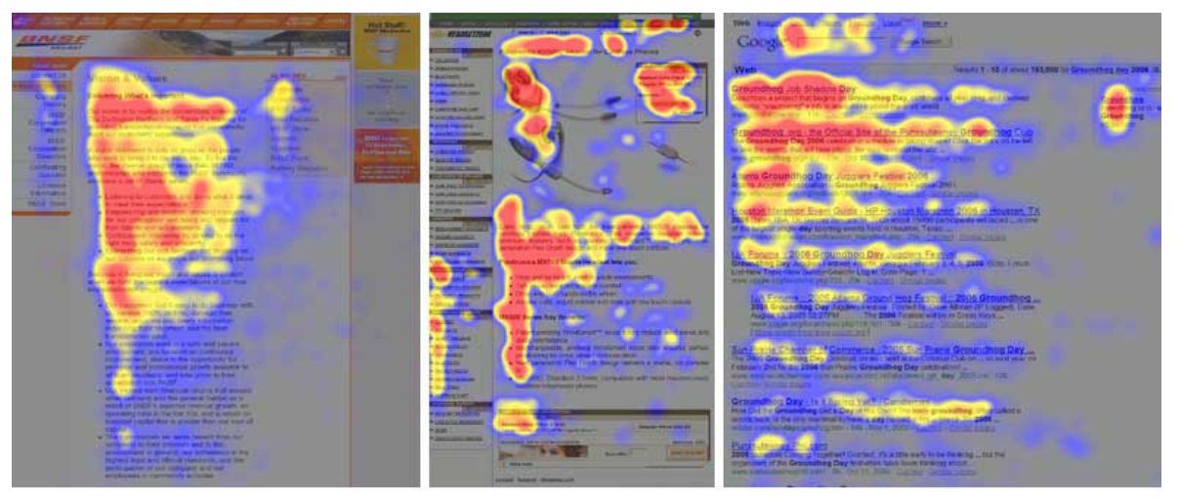
Check 5 (Memos): Watch Your “F-Shape”
Will my readers digest critical information even if they just scan the message? UX research on eye tracking shows that readers scan messages in patterns, the dominant pattern looking like an “F.” Frontload essential information to the top of a message, following bullets, and vertically according to language alignment (i.e., left for English, right for Arabic).
Source: Nielsen Norman Group

Slide 8
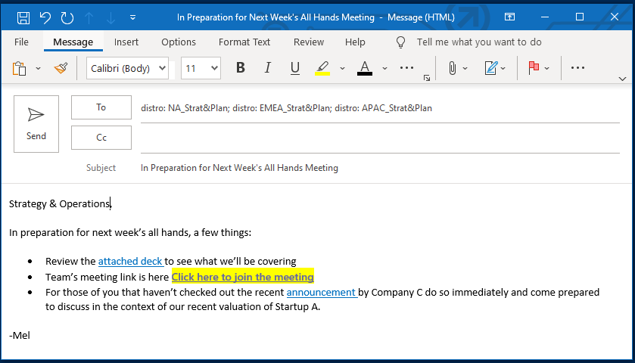
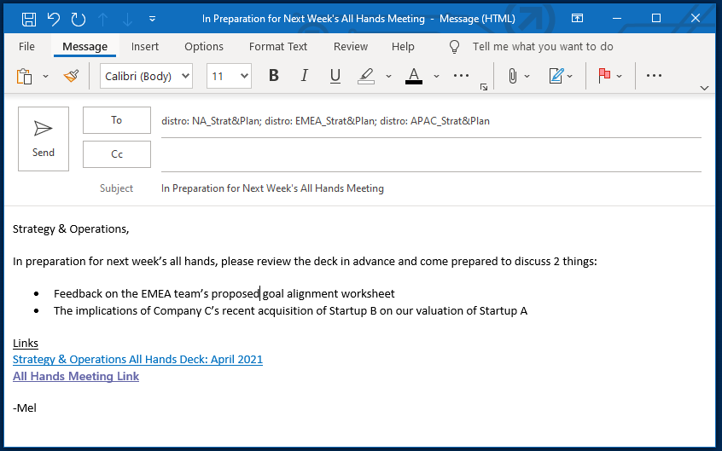
Check 6 (Memos): Hyperlink With Caution
Are my hyperlinks distracting readers from the message? UX research shows that, while readers’ eyes are drawn to hyperlinks, reading comprehension around the hyperlink decreases, and if readers click a link they are unlikely to return to the original message. Avoid leveraging hyperlinks to convey essential information, be selective about which hyperlinks to include and place them after the essential information of your message.
Source: Content Design London

